Slide 1

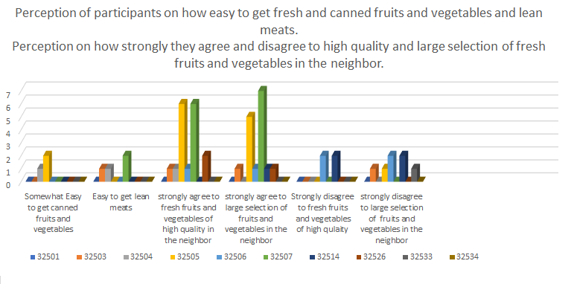
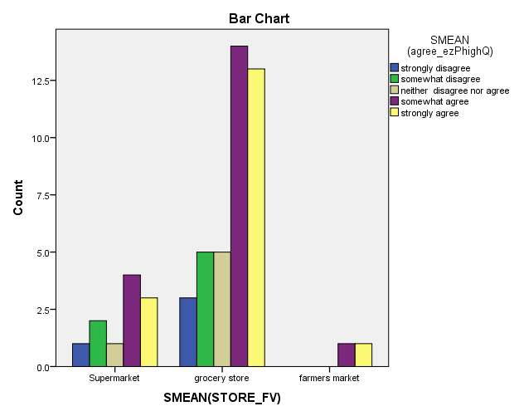
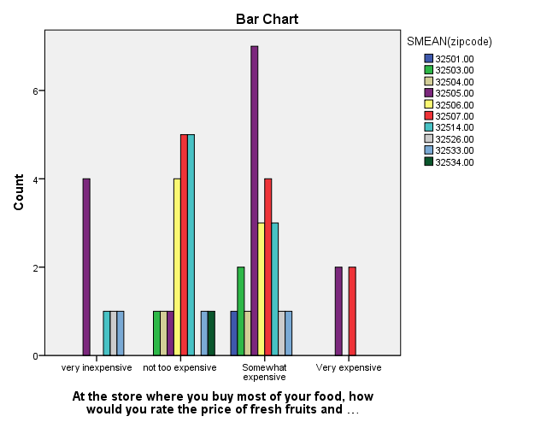
Namita Mishra (Graduate student-Masters in Public Health)
Usha Kundu, MD College of Health
University of West Florida
Faculty advisor: Dr. Melanie SuttonUWF) ; Dr. Daudet Ilunga Tshiswaka (UWF)
Preceptor: Dr. John J. Lanza
Florida Department of Health Escambia County
ABSTRACT
Purpose: To assess the community access to the nutrition and social factors that contribute to lack of access to nutrition and to prevalence of obesity in the community. Method: Observational cross-sectional descriptive study conducted an observational NEMS-CS food inventory survey and NEMS-perceived food access survey. Data was collected on availability of healthy food items in corner stores and on perceptions of community participants of varied demographic characteristics on the decision to shop bases on store types, transport, nutrition, quality, cost of food and effect of relatives and also in importance of these variables. Results: Race, education, employment status and income and location were found to be associated with the individual decision to shop. The transportation and convenience, the store type, high quality and large selection of fruits and vegetables, cost of food, and healthy items available at different stores types and locations were found to influence the individual decision to shop and the participants’ perception on accessibility of fresh produce. The decision to shop based on where relatives shop was found to have a little importance. Conclusion: Extensive data on food environment could contribute to future research and interventions to decrease prevalence of obesity. In future longitudinal studies with better methods and precise measure on food environments changes over time might assess food environmental impact on healthy diet behaviors, and weight outcomes.
INTRODUCTION
Obesity an epidemic affects more than 1.4 billion adults and 40 million children are overweight (WHO). Income and educational inequities play a role in obesity (NHANES).
Technology changed nation’s food system and eating environments (Story, Kaphingst, Robinson-O ’Brien & Glanz, 2008) with high-calorie, low-nutrition food intake (Fox et al., 2009). Cawley & Meyerhoefer (2012) associate high obesity rates with healthcare burden and reduced life expectancy of Americans. Homes, schools, community, and other environments influence diet and health-related behavior (Gamba, Schuchter, Rutt, & Seto, 2015); policies and population-based approaches on obesogenic environment (Dodson, Eyler, Chalifour & Wintrode, 2012; Farley & Van Wye, 2012; Parker, Burns & Sanchez, 2009); community-based zoning practices in the community (Mair, Pierce & Teret, 2005); ecological model of health behavior (Glanz, Sallis, Saelens, & Frank, 2005); urban planning and land use policies (Powell et al., 2007); studies on in-store characteristics (Mancino, & Kinsey, 2008; Neumark-Sztainer, et al., 2003) are a few of the researches on food environment to fight the obesity epidemic.
Community environment, organizational nutrition environments, consumer environment influence the eating behavior. Interventions like Let's Move’ (2013) program by Former First Lady Michelle Obama and food-industry-based programs (calorie labeling and value sizing) (US Food and Drug Administration, 2013); Dietary Guidelines for Americans (US Department of Health and Human Services and Department of Agriculture), taxing unhealthy food and subsidizing healthy food (Rolls, Ello-Martin & Tohill, 2004) facilitate desirable health behavioral change to increase fruits and vegetables consumption.
METHOD
An observational cross-sectional descriptive study on multivariate exposures examines the impact of various social factors on the access to nutrition in the targeted school zones by conducting: An observational NEMS-CS food inventory(16) survey and NEMS-PS perceived food access survey (n=53). NEMS-CS scoring was used to calculate the number of healthy items based on number of healthy items, availability, varieties and the cost. NEMS-PS collected data on transportation used and included participants’ personal and demographic characteristics, health information, food aid, on decision to shop and on the availability of fresh fruits and vegetables, their cost and varieties in their neighborhoods. Access to nutrition refers to an individual’s ability to find stores, get nutrition and variety healthy food and the paying capacity of the participants for healthy food choices in the community when they need. A healthy nutritious food was referred to as defined by WHO. The descriptive analysis of all demographic variables, and all social factors affecting access to fresh produce were calculated using SPSS Statistical Package for Social Sciences (SPSS) v24 (IBM, Inc.). Bivariate statistical analysis and crosstabulation analyzed the association between social factors and the access to nutrition.
The potential confounders were different areas within the zip code where a participant might live and work and also that participants might prefer a ride rather than driving separately to reach the shop from the workplace or home.
Discussion
The access to nutritious food has significant association with obesity independent of individual-level characteristics (age, race, and socioeconomic status) with known associations to obesity. The difficulties of food accessibility related to the decision to shop based on importance of food quality, cost, nutritional and transport varies with the factors like car or motorbike ownership, convenience, and easy availability, time to travel to the shop, type of store, high quality and large selection of fresh fruits and vegetables in the community.
Individual level factors like race, income, and education affect the food accessibility in the neighbor. The study finds that African Americans, high school graduates, low income group, with food aid, travel by car, mostly go to grocery stores and require less than 10 minutes. The majority participants agree to easy availability of high quality fresh fruits and vegetables in their neighbor. The current study supports some of the past research findings. The study limitation is its cross-sectional analysis and the limited details on neighborhoods and individual behaviors that evolve over time and could bias the result estimates.
Conclusions
REFERENCES
Story, M., Kaphingst, K. M., Robinson-O ’Brien, R., & Glanz, K. (2008). Creating healthy food and eating environments: Policy and environmental approaches. Annual Review of Public Health 29:253–272 DOI: 10.1146/annurev.publhealth.29.020907.090926
Fox, M. K., Gordon, A., Nogales, R., & Wilson, A. (2009). Availability and consumption of competitive foods in U.S. public schools. Journal of the American Dietetic Association 109(2), S57–S66. Retrieved from https://www.ncbi.nlm.nih.gov/pubmed/19166673
Cawley, J., Meyerhoefer, C. (2012). The medical care costs of obesity: an instrumental variables approach. J Health Econ, 1, 219-30. doi: 10.1016/j.jhealeco.2011.10.003.
Gamba, R. J., Schuchter, J., Rutt, C., & Seto, E. Y. W. (2015). Measuring the food environment and its effects on obesity in the united states: A systematic review of methods and results. J Community Health 40:464–475 DOI 10.1007/s10900-014-9958-z
Dodson, E. A., Eyler, A. A., Chalifour, S., & Wintrode, C. G. (2012). A review of obesity-themed policy briefs. Am J Prev Med, 3 (3S2), S143–8. doi: 10.1016/j.amepre.2012.05.021.
Farley, T. A., & Van Wye, G. (2012). Reversing the obesity epidemic: The importance of policy and policy research. Am J Prev Med., 43 (3S2), S93–4. Retrieved from https://www.ncbi.nlm.nih.gov/pmc/articles/PMC4333683/
Parker, L., Burns, A.C., Sanchez, E. Institute of medicine, national research council of the national academies. Local government actions to prevent childhood obesity. Washington, DC: National Academies Press, 2009
Glanz, K., Sallis, J. F., Saelens, B. E., & Frank, L. D. (2005). Critical issues and trends healthy nutrition environments: Concepts and measures. Am J Health Promot 19(5):330–333 Retrieved from https://pdfs.semanticscholar.org/e34b/bd76486cc91773d074ab0c0b4763eb520f53.pdf
Mancino, L., & Kinsey, J. (2008). Is dietary knowledge enough? Hunger, stress, and other roadblocks to healthy eating. USDA economic research service. Retrieved from https://www.ers.usda.gov/webdocs/publications/46048/12028_err62fm_1_.pdf?v=41319
Neumark-Sztainer, D., Hannan, P. J., Story, M., Croll, J., & Perry, C (2003). Family meal patterns: Associations with sociodemographic characteristics and improved dietary intake among adolescents. Journal of the American Dietetic Association. 103(3):317–322 DOI 10.1053/jada.2003.50048
Let's Move? (2013). September is fruits & veggies—more matters month. Available at http://www.letsmove.gov/blog/2013/09/16/september-fruits-veggies-%E2%80%94-more-matters-month.
US Food and Drug Administration November 2013 (2010). Menu and vending machines labeling requirements. Available at http://www.fda.gov/Food/IngredientsPackagingLabeling/LabelingNutrition/ucm217762.htm.
Rolls, B.J., Ello-Martin, J.A., & Tohill, B.C. (2004). What can intervention studies tell us about the relationship between fruit and vegetable consumption and weight management? Nutr Rev. 62(1):1–17
People living in neighborhoods with higher density of storefronts with high cost fresh produce and less number of healthy items are more likely to be obese. These neighborhoods might be the optimal sites for interventions. Placing community supermarkets to improve access should have better prices for healthy foods. Longitudinal studies on the complex, interrelated processes and the high-quality data from food stores, multiple environments and locations could support the relations between the individual-level shopping decisions as well as the purposeful placement of food environment resources across social and geographic space. Collaborative efforts of health researchers, communities, city planners, and policy experts and community members will be central to decreasing rates of obesity.
Results
Perception of participant about how hard is it to get fresh produce in their community
=
NEMS-CS with number of healthy items at different stores surveyed
Aim
To advance the previous studies, to assess the access to the nutrition in the community. To integrate knowledge about nutritious foods into community health policies and as a data collection tools utilized by health departments. To propose plans based on access to nutritious foods by increasing the availability of nutritious food items and decreasing the proportion of obese people in areas. To propose sustainable data collection plans for obesity monitoring in targeted communities
Perception of participants whether they agree or disagree to the high quality fresh produce availability and their cost at different stores in their neighborhood in the two graphs
Disclosure
The authors have no financial disclosures that would be a potential conflict of interest with this presentation.

